Slide 1

Digital Marketing
Dr. Priyanka Shrivastava

Slide 2
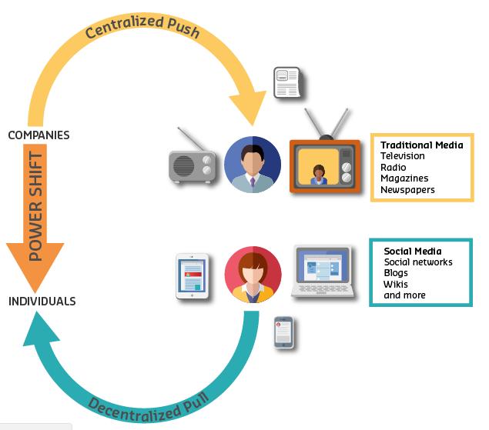
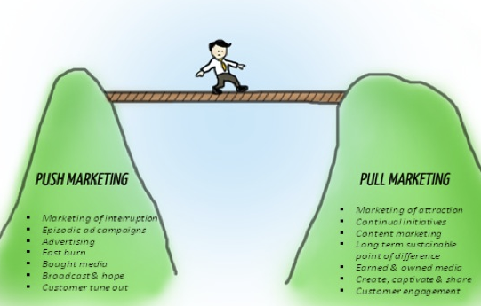
Communication in digital world

Slide 3
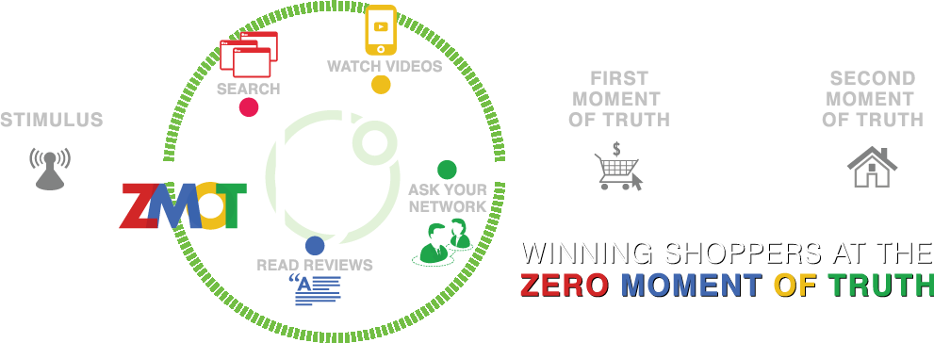
Importance of Digital Presence

Slide 4
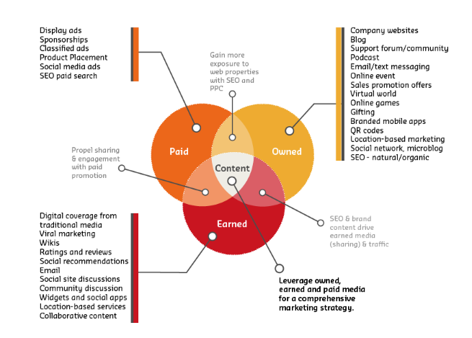
Promotion Strategies in digital world

Slide 5
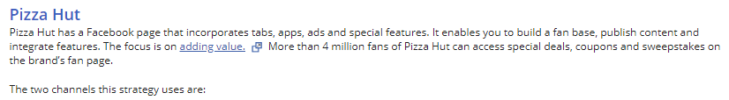
Communication in digital world
a. Paid and Owned
b. Owned and Earned
c. Paid and Earned

Slide 6
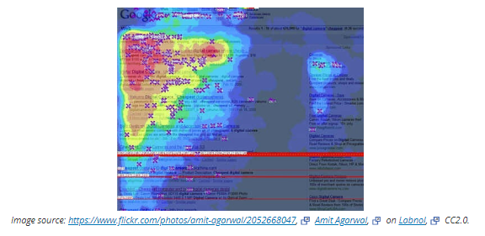
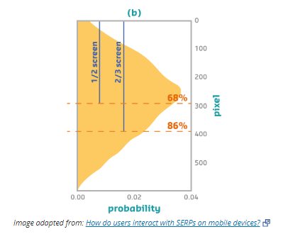
Layout of Website Content

Slide 7
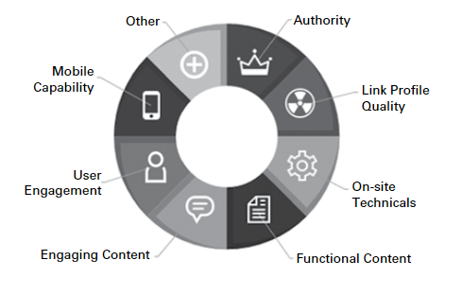
History of SEO
Pre 2003
Keyword density played the major role
Page title, Meta data & Body copy
2004-11
Link Volume
Anchor Text (Clickable text in hyperlink)
2011 onwards
User Experience
Substantially Unique

Slide 8
Search Engine Marketing-SEM
SEO
Keywords
Paid Search
Pay Per Click (PPC)
Anchor Text
User Experience
Cost per impressions (CPM)
Cost per Action (CPA)
“SEM is a form of Digital Strategy that seeks to promote websites by increasing their visibility in search engine results”

Slide 9
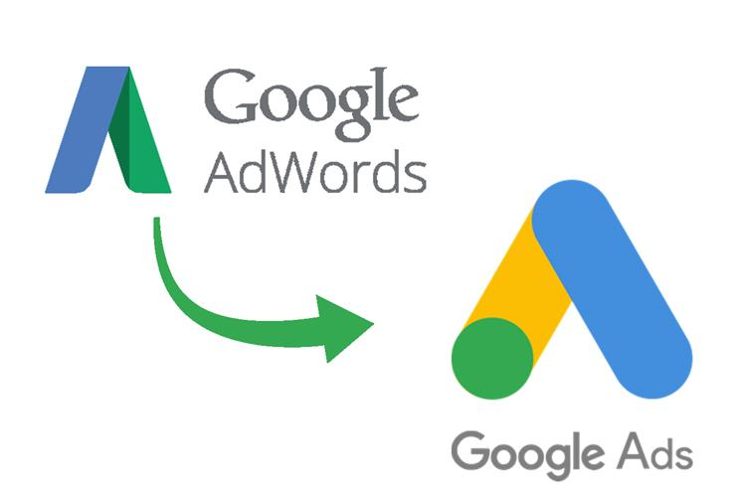
Use negative keywords list
Organize keywords by ad groups
Think like a customer
General Keywords will reach more people
“Broad Match, Phrase Match, Exact Match, Negative Match”

Slide 10
New Media – New Data – New Metrics
Web has created numerous measurement opportunities
Data tools and techniques are easily available
Marketers can answer critical questions using data

Slide 11

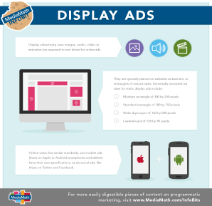
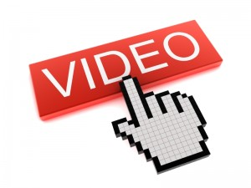

Channels to develop customer relationships in digital world

Slide 12
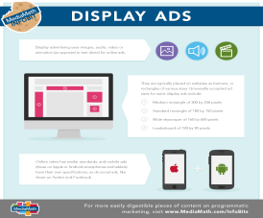

Key Search Metrics
Click Through rates (CTR)
Transaction conversion rates (TCR)
Cost per acquisition (CPA)

Slide 13
Key Display Ads Metrics
Click Through rates (CTR)
Transaction conversion rates (TCR)
Cost per acquisition (CPA)
Events/ Visits

Slide 14
Key Video Marketing Metrics
Video Views
Play through Rate
Engagement Rate

Slide 15
Key Social Media Metrics
Audience growth
Amplification rate
Applause rate
Micro Conversion Rate

